Slide 1

Software PROCESS MODELS
Dr. Inderveer Chana | Dr. Ashima Singh | Ms. Harkiran Kaur
Professor and Associate Head CSED, Dean of Student Affairs, TIET, Patiala | Assistant Professor CSED, TIET, Patiala | Assistant Professor CSED, TIET, Patiala
Computer Science and Engineering Department, TIET, Patiala

Slide 2
software PROCESS MODELS
WATERFALL MODEL
V – MODEL
RAD MODEL

Slide 3
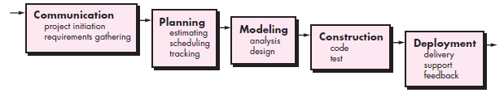
a. waterfall MODEL

Slide 4
WATERFALL MODEL - APPLICABLE WHEN ?
Well understood requirements for the problem
Well-defined enhancements, or adaptations required for an existing system
For example, an adaptation to accounting software, that has been mandated, because of changes to government regulations

Slide 5
WATERFALL MODEL - LIMITATIONS
Real projects rarely follow the sequential flow
Difficult to state all the requirements at the beginning of the project.
Model is not suitable to accommodate changes.
Working software is not available to the customer until late in the project schedule.
Major mistakes may be detected during the SDLC process.
Bradac [Bra94] found “blocking states” problem – Task dependency and waits.
Inappropriate for developing actual software

Slide 6
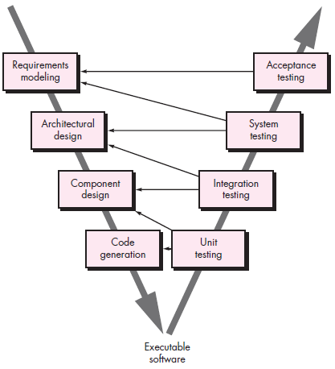
B. V – MODEL
Variation of Waterfall model.
Right side of the V → series of tests, and quality assurance actions.
No fundamental difference between waterfall model and V – model
Provides a way for visualizing that how verification, and validation actions, are applied to earlier software engineering work.

Slide 7
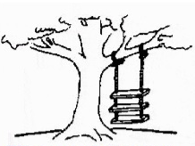

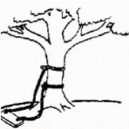

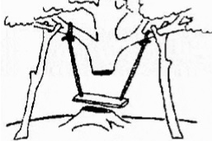

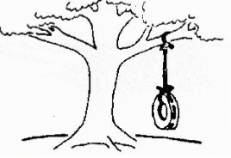
c. Rapid application development (rad) MODEL
Requirements specified like this
What Project leader understood
What Developers wrote
How the business consultants described it
What operations installed
How the customer was billed
What the customer actually required

Slide 8
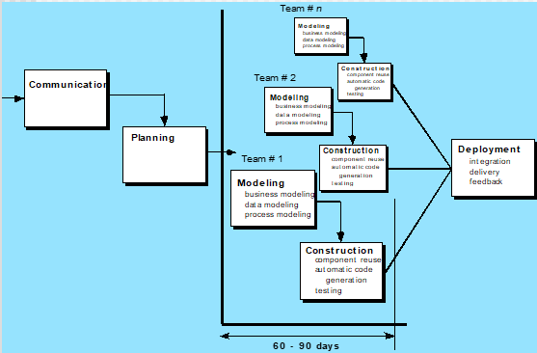
c. Rapid application development (rad) MODEL
…User participation is essential
Build a rapid prototype
User evaluates the prototype and gives feedback
Prototype is refined → requirements and scope well understood
Incremental model → 60 to 90 days
Project activities conducted by different RAD teams, increment wise

Slide 9
RAD MODEL - LIMITATIONS
Not an appropriate model in the absence of user involvement.
Reusable components are required to reduce the development time.
Highly specialized and skilled developers are required.
Requires sufficient human resources to form suitable number of RAD teams.

Slide 10
References:
Pressman, R. Software Engineering: A Practitioner’s Approach. McGraw-Hill

